Slide 1
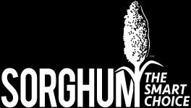
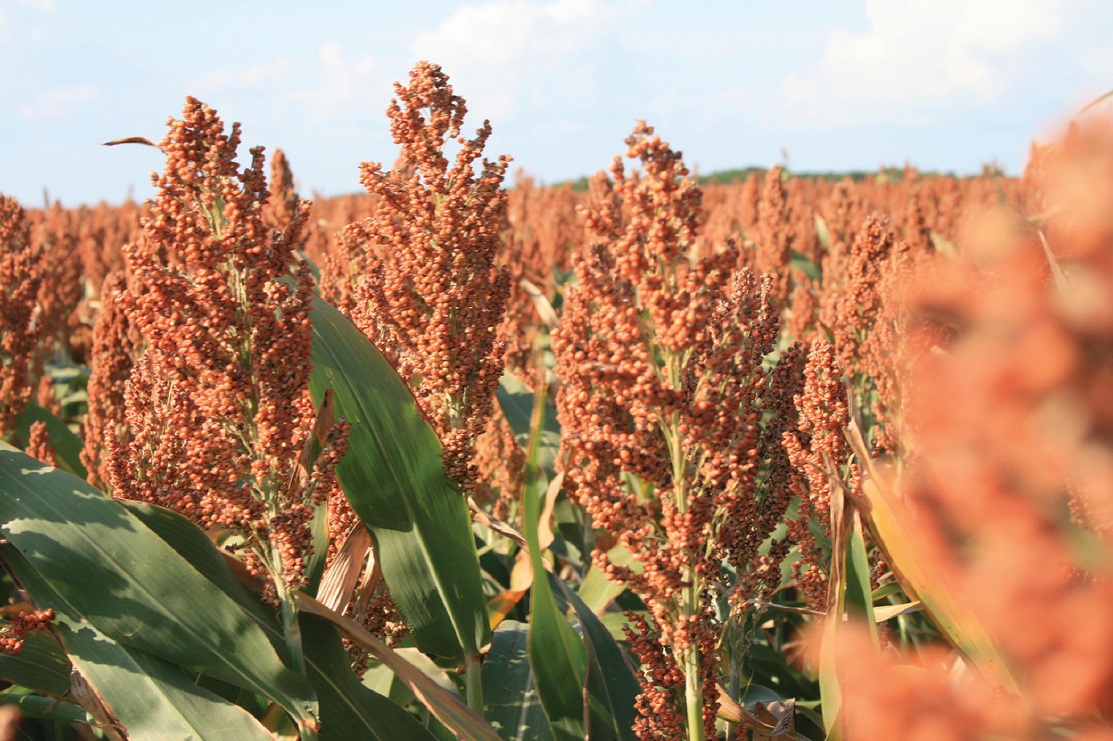
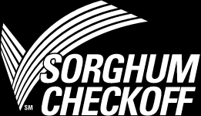
美国高粱收获品质报告和市场展望
网络会议 | 2022年3月31日
U.S. Sorghum Harvest Quality Report and
Market Outlook
Webinar | March 31, 2022

Slide 2
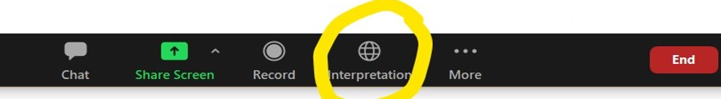
同传提醒
Translation Notice
请选择“中文”频道接收同传翻译

Slide 3


佩吉·史蒂文森
Paige Stevenson
佩吉·史蒂文森是美国谷物协会全球贸易经理。美国谷物协会是一个非营利组织，在全球范围内推广使用美国大麦、玉米、高粱和相关产品。佩吉的工作主要向协会成员和客户提供贸易服务专业知识，进一步开发美国饲料谷物的出口市场，并加强美国谷物协会与世界各地贸易商的关系。 在加入协会之前，史蒂文森在邦吉北美公司工作，她曾负责过多个职位的工作，包括从田间的谷物采购到处理流向美国海湾的出口物流。 佩吉拥有普渡大学大学农业企业学士学位。

Slide 4
2021/2022
高粱品质报告
Sorghum Quality Report
Paige Stevenson
Manager of Global Trade
U.S. Grains Council
Notes:
The U.S. Grains Council (Council) is pleased to present the findings from its 2021/2022 Sorghum Quality Report. This is the third annual edition of a report designed to provide international customers and other interested parties with accurate, unbiased information about the quality of the U.S. sorghum crop. A total of 97 samples were collected from the outbound shipments of U.S. country elevators and large farmers and analyzed for the grade factors established by the U.S. Department of Agriculture as well as chemical composition and other quality characteristics not reported elsewhere. The results are summarized at the U.S. Aggregate level.

Slide 5
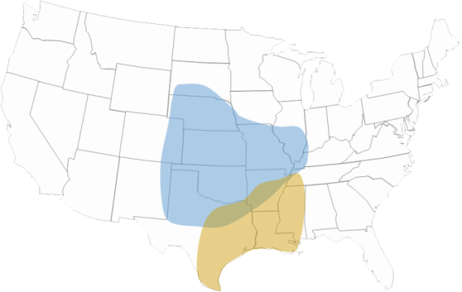
出口区
“Export Regions” (ERs)
收集自出口区的97个样本，基本代表了100% 的美国出口高粱
97 samples
collected from ERs
representing approximately
100% of U.S. Sorghum exports
晚收区
Late Harvest
82.5%
早收区
Early Harvest
17.5%
Notes:
Sorghum production in the United States can be grouped into the two main harvest areas shown in the map below (the Early Harvest Area and the Late Harvest Area). For this 2021/2022 Sorghum Quality Report, the target population was sorghum from these two key U.S. sorghum-producing areas representing nearly 100% of the U.S. sorghum exports. The results reflect the quality of blended samples pulled from the outbound sorghum shipments of U.S. elevators and a large sorghum producer.
The targeted number of samples were proportionately stratified according to each sorghum-producing area’s share of total U.S. sorghum exports, as shown on the map.
A total of 97 blended sorghum samples from thirteen participating elevators and one participating farmer were received from September 20, 2021, through February 16, 2022. Samples were received by the Amarillo Grain Exchange, Inc. in Amarillo, Texas, and tested for the sorghum grade factors. The samples were then sent to the Cereal Quality Lab at Texas A&M University in College Station, Texas, for chemical composition and physical factor analysis.
Averages and standard deviations for each quality factor were calculated for the Early Harvest Area and the Late Harvest Area. The U.S. Aggregate average and standard deviation were then calculated based on each Harvest Area’s proportion of total U.S. sorghum exports following standard statistical techniques for proportionate stratified sampling. The results are reported only for the U.S. Aggregate and not the individual harvest areas.

Slide 6
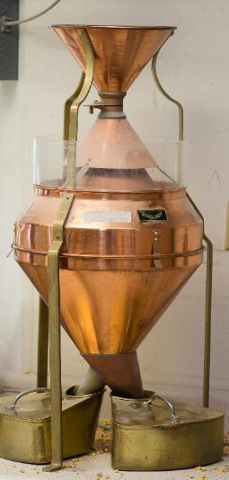
品质指标检测
Quality Factors Tested
等级指标Grading Factors
  容重 Test weight
  破碎粒和杂质 BNFM
  杂质 Foreign material
  总损伤 Total damage
  热损伤 Heat damage
化学成分 Chemical Composition
蛋白 Protein
淀粉 Starch
油 Oil
单宁 Tannins
物理指标 Physical Factors
籽粒直径 Kernel diameter
千粒重 1000-kernel weight
籽粒硬度指数
Kernel hardness index
Notes:
The Sorghum Quality Report includes quality tests for the following factors:
U.S. Grade factors – this includes test weight, “broken kernels and foreign material” commonly referred to as BNFM, total damage and heat damage, a subset of total damage.
Chemical composition consisting of protein, starch and oil,
Tannins
Physical factors measuring kernel diameter, 1000-kernel weight and kernel hardness index

Slide 7
等级指标
Grade Factors
Notes:
The first set of test results we will present is for the grade factors.

Slide 8
等级和指标
Grades and Grade Requirements
 | 最小Minimum |  | 最大限值 Maximum Limits of
 | 容重Test Weight |  | 损伤粒 Damaged Kernels |  | 破碎粒和杂质 Broken Kernels and Foreign Material
等级 Grade | 磅/蒲Pounds per Bushel | 公斤/百升Kilograms per Hectoliter | 热损 Heat Damage (%) | 总损 Total (%) | 杂质Foreign Material (%) | 破碎粒和杂质 BNFM (%)
U.S. No. 1 | 57.0 | 72.1 | 0.2 | 2.0 | 1.0 | 3.0
U.S. No. 2 | 55.0 | 69.5 | 0.5 | 5.0 | 2.0 | 6.0
U.S. No. 3 | 53.0 | 66.9 | 1.0 | 10.0 | 3.0 | 8.0
U.S. No. 4 | 51.0 | 63.1 | 3.0 | 15.0 | 4.0 | 10.0
Notes:
U.S. sorghum is traded based on grades established by the U.S. government. In order to meet the requirements for a given grade of sorghum, a load of sorghum must achieve the minimum standards for test weight and not exceed maximum standards for heat damage, total damaged kernels, foreign material and BNFM of that grade.
The key grading factors as shown here are:
Test weight – the chart reports the minimum test weight for each grade; for example, the sorghum must have a minimum test weight of 55.0 lb/bu to be U.S. Grade No. 2
The chart reports the maximum level for each of the following three factors:
Heat damage, which is a sub-set of total damage
Total damage,
Foreign material, and
BNFM, which stands for “Broken Kernels and Foreign Material”

Slide 9
等级指标
Grade Factors
 | 样本数Number of Samples | 平均值average | 标准差Standard Deviation | 最小值Minimum | 最大值Maximum
容重Test Weight (lb/bu) | 97 | 59.1 | 1.55 | 52.9 | 62.0
容重Test Weight (kg/hl) | 97 | 76.1 | 1.99 | 68.1 | 79.8
破碎粒和杂质BNFM (%) | 97 | 1.5 | 0.85 | 0.1 | 7.3
杂质 Foreign Material (%) | 97 | 0.7 | 0.53 | 0.0 | 2.6
总损Total Damage (%) | 97 | 0.0 | 0.16 | 0.0 | 1.8
热损Heat Damage (%) | 97 | 0.0 | 0.00 | 0.0 | 0.0
Notes:
This table presents the grade factor results at the U.S. Aggregate level. The U.S. Aggregate includes the entire number of samples collected and tested for this year’s Sorghum Quality Report. The average, standard deviation, minimum and maximum values for each of the quality factors are shown here. For example, we can see that the average test weight for the U.S. Aggregate was 59.1 pounds per bushel or 76.1 kilograms per hectoliter. The standard deviation for test weight was 1.55 lb/bu or 1.99 kg/hl. The lowest and highest test weights seen in the 97 samples were 52.9 and 62.0 lb/bu, respectively.​
​
We will review the results for each of the quality factors on the following slides.

Slide 10
容重
Test Weight
美国总体 U.S. Aggregate: 59.1 lb/bu
  平均值高于2020/2021 (58.3 lb/bu 或75.1 kg/hl) 和2019/2020 (58.9 lb/bu 或 75.8 kg/hl)
  Average higher than 2020/2021 (58.3 lb/bu or 75.1 kg/hl) and 2019/2020 (58.9 lb/bu or 75.8 kg/hl)
  平均值高于美国一级高粱的最小限值(57.0 lb/bu 或73.4 kg/hl)
  Average higher than minimum for U.S. No. 1 grade (57.0 lb/bu or 73.4 kg/hl)
Notes:
Average: 59.1 lb/bu (76.1 kg/hl), higher than 2020/2021 (58.3 lb/bu or 75.1 kg/hl), 2019/2020 (58.9 lb/bu or 75.8 kg/hl) and the minimum for U.S. No. 1 grade (57.0 lb/bu or 73.4 kg/hl)
Standard deviation: 1.55 lb/bu (1.99 kg/hl), lower than 2020/2021 (1.92 lb/bu or 2.47 kg/hl) and 2019/2020 (1.59 lb/bu or 2.04 kg/hl)
Test weight is defined as the weight of grain required to fill a specific volume (Winchester bushel). This measure of bulk density is often used as a general indicator of overall quality and as a gauge of endosperm hardness for value-added processing.
The test involves filling a test cup of known volume through a funnel held at a specific height above the test cup to the point where grain begins to pour over the sides of the test cup. A strike-off stick is used to level the grain in the test cup, and the grain remaining in the cup is weighed. The weight is then converted to and reported in the traditional U.S. unit, pounds per bushel (lb/bu).

Slide 11
破碎粒和杂质
Broken Kernels & Foreign Material (%)
美国总体 U.S. Aggregate: 1.5%
  平均值低于2020/2021 (1.6%)和 2019/2020 (1.7%)
  Average lower than 2020/2021 (1.6%) and 2019/2020 (1.7%)
  平均值低于美国一级高粱最大限值
  Average lower than the maximum for U.S. No. 1 grade (3.0%)
Notes:
Average: 1.5%, lower than 2020/2021 (1.6%), 2019/2020 (1.7%) and the maximum for U.S. No. 1 grade (3.0%)
Standard deviation: 0.85%, lower than 2020/2021 (1.08%) and higher than 2019/2020 (0.74%)
Broken kernels and foreign material (BNFM), an indicator of the amount of clean, sound sorghum available for feed and processing, is reported as the sum of broken kernels as a percent of the dockage-free sample weight and the foreign material.
Broken kernels is defined as all material that passes through a 5/64th-inch triangular-hole sieve and over a 2.5/64th-inch round-hole sieve. Foreign material is defined as all material, except sorghum, that remains on top of the 5/64th-inch triangular-hole sieve and all matter other than sorghum, which passes over a No. 6 riddle. Foreign material is reported as a sum of the mechanically-separated foreign material as a percent of the dockage free sample weight and the handpicked foreign material as a percent of the handpicked sample portion weight.

Slide 12
杂质
Foreign Material (%)
美国总体U.S. Aggregate: 0.7%
  平均值高于2020/2021 (0.6%) 和2019/2020 (0.5%)
  Average higher than 2020/2021 (0.6%) and 2019/2020 (0.5%)
  平均值低于美国一级高粱最大限值(1.0%) Average lower than the maximum for U.S. No. 1 grade (1.0%)
Notes:
Average: 0.7%, higher than 2020/2021 (0.6%) and 2019/2020 (0.5%) but below the maximum for U.S. No. 1 grade (1.0%)
Standard deviation: 0.53%, higher than 2020/2021 (0.45%) and 2019/2020 (0.40%)
Foreign material, a part of BNFM, consists of non-sorghum material and dust. Foreign material is generally higher in moisture content than the sorghum itself and reduces feed and processing value.

Slide 13
总损
Total Damage (%)
美国总体U.S. Aggregate: 0.0%
  平均值于2020/2021相同，低于2019/2020 (0.2%)
  Average same as 2020/2021 (0.0%) and lower than 2019/2020 (0.2%)
  平均值低于美国一级高粱最大限值(2.0%) Average lower than the maximum for U.S. No. 1 grade (2.0%)
Notes:
Average: 0.0%, same as 2020/2021 (0.0%) and lower than 2019/2020 (0.2%) and the maximum for U.S. No. 1 grade (2.0%)
Standard deviation: 0.16%, lower than 2020/2021 (0.26%) and 2019/2020 (0.89%)
Total damage is the percentage of kernels and pieces of kernels that are damaged in some way. A representative working sample of 15 grams of BNFM-free sorghum is visually examined by a properly trained individual for the content of damaged kernels. Types of damage include germ-damaged kernels, ground- or weather-damaged kernels, diseased kernels, frost-damaged kernels, heat-damaged kernels, insect-bored kernels, mold-damaged kernels (surface or internal), mold-like substance, purple-pigment-damaged kernels and sprout-damaged kernels. Total damage is reported as the weight percentage of the working sample that is total damaged grain.

Slide 14
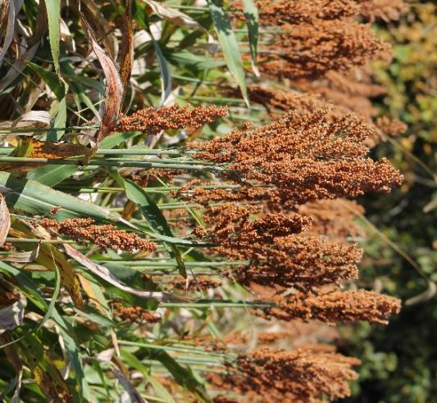
热损
Heat Damage (%)
美国总体U.S. Aggregate: 0.0%
  未观察到热损伤，与2020/2021年和2019/2020年相同
  No heat damage was observed, same as in 2020/2021 and 2019/2020
  平均值低于美国一级高粱最大限值
  Average below the limit for U.S. No. 1 Grade
  表明对高粱的干燥和储存进行了良好的管理
  Indicates good management of the drying and storage of sorghum
Notes:
Average: 0.0%, no heat damage was observed, same as in 2020/2021 and 2019/2020
Heat damage is a subset of total damage and consists of kernels and pieces of sorghum kernels that are materially discolored and damaged by heat. It occurs during heated air drying or in storage. Heat-damaged kernels are determined by a properly trained individual visually inspecting a 15-gram sample of BNFM-free sorghum. Heat damage, if found, is reported separately from total damage.

Slide 15
单宁
Tannins
Notes:
The first set of test results we will present is for the grade factors.

Slide 16
单宁
Tannins (mg CE/g)
美国总体U.S. Aggregate: <4.0%
  所有样本中的单宁水平都低于4.0毫克铈/克，这意味着没有单宁，与2020/2021年和2019/2020年的情况相同。
  Tannin levels in all samples were less than 4.0 mg CE/g, implying an absence of tannins, the same as in 2020/2021 and 2019/2020.
Notes:
Tannin levels in all 97 samples were less than 4.0 mg CE/g, implying an absence of tannins, the same as in 2020/2021 and 2019/2020.
Tannins are present in sorghum varieties that have a pigmented testa within their kernels. Tannins affect nutritional and functional properties as a result of interactions of the tannins in sorghum-containing rations. Values near or below 4.0 mg catechin equivalents (CE) per gram (g) sample by this method generally imply the absence of condensed tannins. Type III tannin sorghums usually have values greater than 8.0 mg CE/g.
Leucoanthocyanidins (catechins) and proanthocyanidins (tannins) are a class of flavonoids known as flavanols that react with vanillin in the presence of mineral acids to produce a red color. Vanillin reacts with flavanols, but other flavonoid compounds can give specific color development. The test involves grinding approximately 50 g of sound seed using a UDY grinder with a 1 mm sieve and accurately weighing 0.30 g of this sample for analysis. Extraction and analysis are performed using the vanillin-HCl test with blank subtraction to remove interference by sorghum pigments. Developed color is measured using a UV-Vis spectrophotometer at 500 nanometers. A standard curve is run using pure catechin. Tests are run in triplicates, and the average value is reported as mg CE/g sample on a dry basis.

Slide 17
化学成分
Chemical Composition
Notes:
Chemical composition of sorghum is important because the components of protein, starch and oil are of significant interest to end-users. These attributes provide additional information related to nutritional value for livestock and poultry feeding and other processing uses of sorghum. Chemical composition tests for protein, oil and starch were conducted using an approximately 50-gram sample in a Perten DA 7250 Near-Infrared Reflectance (NIR) instrument. Results are reported on a dry basis (percent of non-water material).

Slide 18
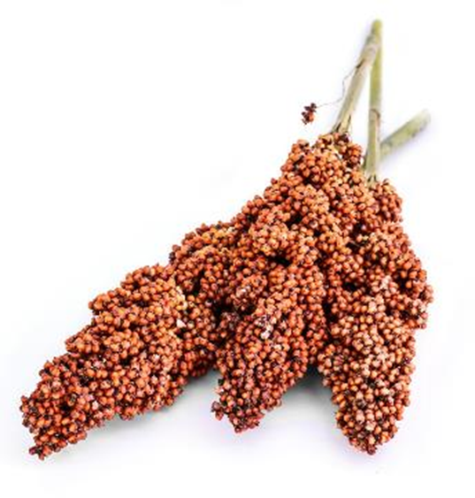
化学成分
Chemical Composition
对家禽和家畜饲养至关重要
供应必需氨基酸
Important for poultry
and livestock feeding
Supplies essential amino acids
Influenced by
遗传、天气、作物产量和生长季节的可用氮元素
Genetics, weather, crop yields and
available nitrogen
during the growing season
影响因素 Influenced by
遗传、天气、作物产量
Genetics, weather
and crop yields
对湿磨法和干磨法乙醇生产商很重要
Important for wet millers and dry-grind ethanol manufacturers
对湿磨法和干磨生产很重要Important by-product
of wet and dry milling
饲料的关键成分
Essential feed component
Notes:
Protein is important for poultry and livestock feeding and supplies essential amino acids. Protein content is influenced by genetics, weather, crop yields and available nitrogen during the growing season.
Starch is important for wet millers and dry-grind ethanol manufacturers, while oil is an important by-product of wet and dry milling, and an essential feed component. Both starch and oil contents are influenced by genetics, weather and crop yields.
The weather conditions during the grain-filling period in July and August are critical to determining final grain composition. During this time, moderate rainfall and cooler-than-average temperatures, especially overnight temperatures, promote starch and oil accumulation and increased yields. Moderate rainfall and warm temperatures in the second half of grain-fill (August to September) also aid continued nitrogen uptake and photosynthesis. Nitrogen also remobilizes from the leaves to the grain during late grain-filling, leading to increases in grain protein.

Slide 19
化学成分
Chemical Composition
 | 样本数Number of Samples | 平均值Average | 标准差Standard Deviation | 最小值Minimum | 最大值Maximum
蛋白（干基0%） Protein (Dry Basis %) | 97 | 11.3 | 0.89 | 9.2 | 14.5
淀粉（干基0%） Starch (Dry Basis %) | 97 | 73.4 | 0.97 | 71.2 | 75.5
油（干基0%） Oil (Dry Basis %) | 97 | 4.7 | 0.32 | 2.9 | 5.2
Notes:
This table presents the chemical composition results at the U.S. Aggregate level. The U.S. Aggregate includes the entire number of samples collected and tested for this year’s Sorghum Quality Report. The average, standard deviation, minimum and maximum values for each of the quality factors are shown here. For example, we can see that the average protein for the U.S. Aggregate was 11.3%. The standard deviation for protein was 0.89%. The lowest and highest values seen in the 97 samples were 9.2 and 14.5%, respectively.​
Chemical composition of sorghum is important because the components of protein, starch and oil are of significant interest to end-users. These attributes provide additional information related to nutritional value for livestock and poultry feeding and other processing uses of sorghum. Chemical composition tests for protein, oil and starch were conducted using an approximately 50-gram sample in a Perten DA 7250 Near-Infrared Reflectance (NIR) instrument. Results are reported on a dry basis (percent of non-water material).

Slide 20
蛋白（干基0%）
Protein (Dry Basis %)
美国总体U.S. Aggregate: 11.3%
  平均值高于2020/2021(11.2%) 和 2019/2020 (10.4%)
  Average higher than 2020/2021 (11.2%) and 2019/2020 (10.4%)
Notes:
Protein is very important for poultry and livestock feeding, as it supplies essential sulfur-containing amino acids and improves the feed conversion efficiency. Protein is usually inversely related to starch concentration. Results are reported on a dry basis. The average and standard deviation for the 2021/2022 samples were the following:
Average: 11.3%, higher than 2020/2021 (11.2%) and 2019/2020 (10.4%)
Standard deviation: 0.89%, higher than 2020/2021 (0.79%) and 2019/2020 (0.76%)

Slide 21
淀粉（干基0%）
Starch (Dry Basis %)
美国总体 U.S. Aggregate: 73.4%
  平均值高于2020/2021 (72.6%) and 2019/2020 (72.1%)
  Average higher than 2020/2021 (72.6%) and 2019/2020 (72.1%)
Notes:
Starch is related to metabolizable energy for livestock and poultry. High starch concentration is often indicative of good kernel maturation/filling conditions and reasonably moderate kernel densities. Results are reported on a dry basis. The average and standard deviation for the 2021/2022 samples were the following:
Average: 73.4%, higher than 2020/2021 (72.6%) and 2019/2020 (72.1%)
Standard deviation: 0.97%, lower than 2020/2021 (1.01%) and 2019/2020 (1.21%)

Slide 22
油（干基0%）
Oil (Dry Basis %)
美国总体 U.S. Aggregate: 4.7%
  平均值与2020/2021和2019/2020相同 Average same as 2020/2021 and 2019/2020
Notes:
Oil is an essential component of poultry and livestock rations. It serves as an energy source, enables fat-soluble vitamins to be utilized and provides certain essential fatty acids. Oil may also be an important co-product of sorghum value-added processing. Results are reported on a dry basis. The average and standard deviation for the 2021/2022 samples were the following:
Average: 4.7%, same as 2020/2021 and 2019/2020
Standard deviation: 0.32%, higher than 2020/2021 (0.20%) and 2019/2020 (0.26%)

Slide 23
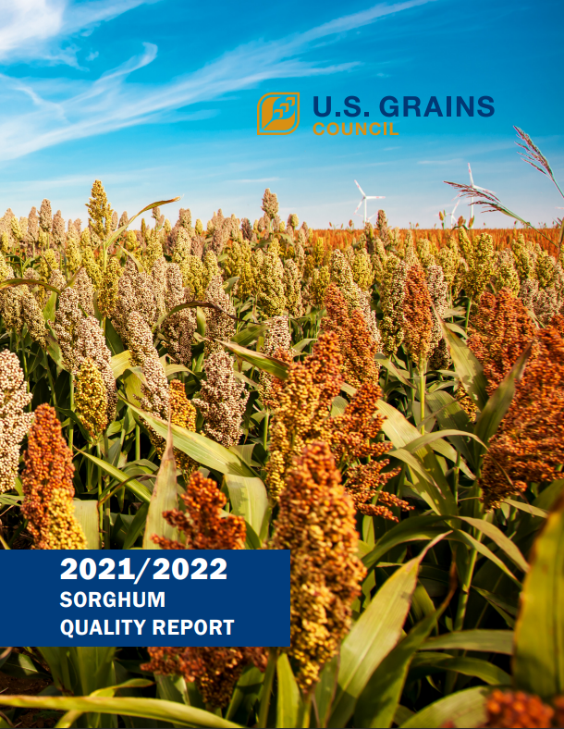
报告要点
Report Highlights
平均而言，2021/2022高粱样品本的所有等级指标都优于或等于美国一级高粱
2021/2022 sorghum samples were, on average, better than or equal to U.S. No. 1 on all grade factors
100%的样品含有低于4.0毫克儿茶素当量(CE)每克。这个水平意味着没有浓缩的单宁。
100% of samples contained below 4.0 mg catechin equivalents (CE) per gram. This level implies the absence of condensed tannins.

Slide 24
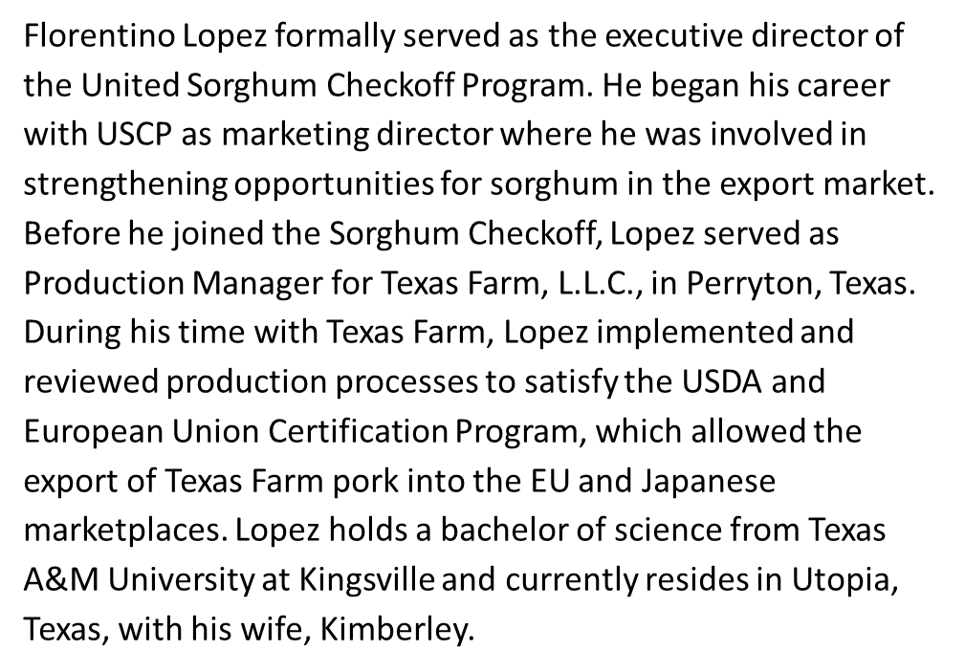

Florentino Lopez

Slide 25
美国高粱生产最新情况
Production Update
U.S. Sorghum

Slide 26
世界高粱产量十年平均值
World Sorghum Production
10 Year Average
FAS Data

Slide 27
世界高粱出口国 十年平均值
World Sorghum Exporters
10 Year Average
FAS Data

Slide 28
世界高粱进口国十年平均值
World Sorghum Importers
10 Year Average
FAS Data

Slide 29

种植预测
Prospective Plantings
-4%
4%
USDA Data
9%
-15%
The information in this report is derived from sources believed to be reliable and accurate . Creando Mañana assumes no responsibility or liability for any errors or omissions in this content. This content is provided on an “as is” basis with no guarantees of completeness, accuracy, usefulness, implied result or timeliness and without any warranties of any kind whatsoever, expressed or implied. The materials, ideas, suggestions, and or other items enclosed within this document are the sole property of Creando Mañana.
Creando Mañana

Slide 30
基于预测种植面积的产量测算
Production based on Prospective Plantings
预计2022年产量 Anticipated 2022 Production
 | 高粱面积 Sorghum Acreage | 6.205
 |  | 产量范围MMT Production Volume Range MMT
单产蒲/英亩 Bu Yield/Ac | 60 Widespread Drought | 9.46
 | 64 Moderate Drought | 10.09
 | 68 Average Conditions | 10.72
 | 72 Good Conditions | 11.35
 | 76 Perfect Conditions | 11.98
USDA Data
The information in this report is derived from sources believed to be reliable and accurate . Creando Mañana assumes no responsibility or liability for any errors or omissions in this content. This content is provided on an “as is” basis with no guarantees of completeness, accuracy, usefulness, implied result or timeliness and without any warranties of any kind whatsoever, expressed or implied. The materials, ideas, suggestions, and or other items enclosed within this document are the sole property of Creando Mañana.
Creando Mañana

Slide 31
种植预测（州）
Prospective Plantings
USDA Data
The information in this report is derived from sources believed to be reliable and accurate . Creando Mañana assumes no responsibility or liability for any errors or omissions in this content. This content is provided on an “as is” basis with no guarantees of completeness, accuracy, usefulness, implied result or timeliness and without any warranties of any kind whatsoever, expressed or implied. The materials, ideas, suggestions, and or other items enclosed within this document are the sole property of Creando Mañana.
Creando Mañana

Slide 32
基于预测种植面积的产量测算
Production based on Prospective Plantings
预计2022年产量 Anticipated 2022 Production
 | 预估单产 Estimated Yield Bu/Ac | 65
 |  | 产量范围MMT Production Volume Range MMT
MT | 堪萨斯州Kansas | 5.12
 | 德克萨斯州 Texas | 2.81
 | 科罗拉多州 Colorado | 0.77
 | 奥克拉荷马州 Oklahoma | 0.69
 | 南达科塔州 South Dakota | 0.40
 | 内布拉斯加州 Nebraska | 0.45
USDA Data
The information in this report is derived from sources believed to be reliable and accurate . Creando Mañana assumes no responsibility or liability for any errors or omissions in this content. This content is provided on an “as is” basis with no guarantees of completeness, accuracy, usefulness, implied result or timeliness and without any warranties of any kind whatsoever, expressed or implied. The materials, ideas, suggestions, and or other items enclosed within this document are the sole property of Creando Mañana.
Creando Mañana

Slide 33
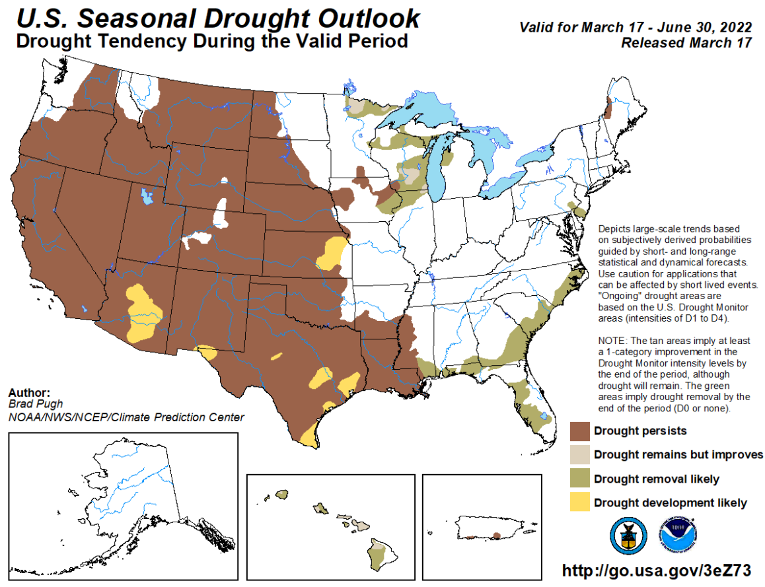
到2022年6月的干旱展望
Drought Outlook through June, 2022
The information in this report is derived from sources believed to be reliable and accurate . Creando Mañana assumes no responsibility or liability for any errors or omissions in this content. This content is provided on an “as is” basis with no guarantees of completeness, accuracy, usefulness, implied result or timeliness and without any warranties of any kind whatsoever, expressed or implied. The materials, ideas, suggestions, and or other items enclosed within this document are the sole property of Creando Mañana.
Creando Mañana

Slide 34
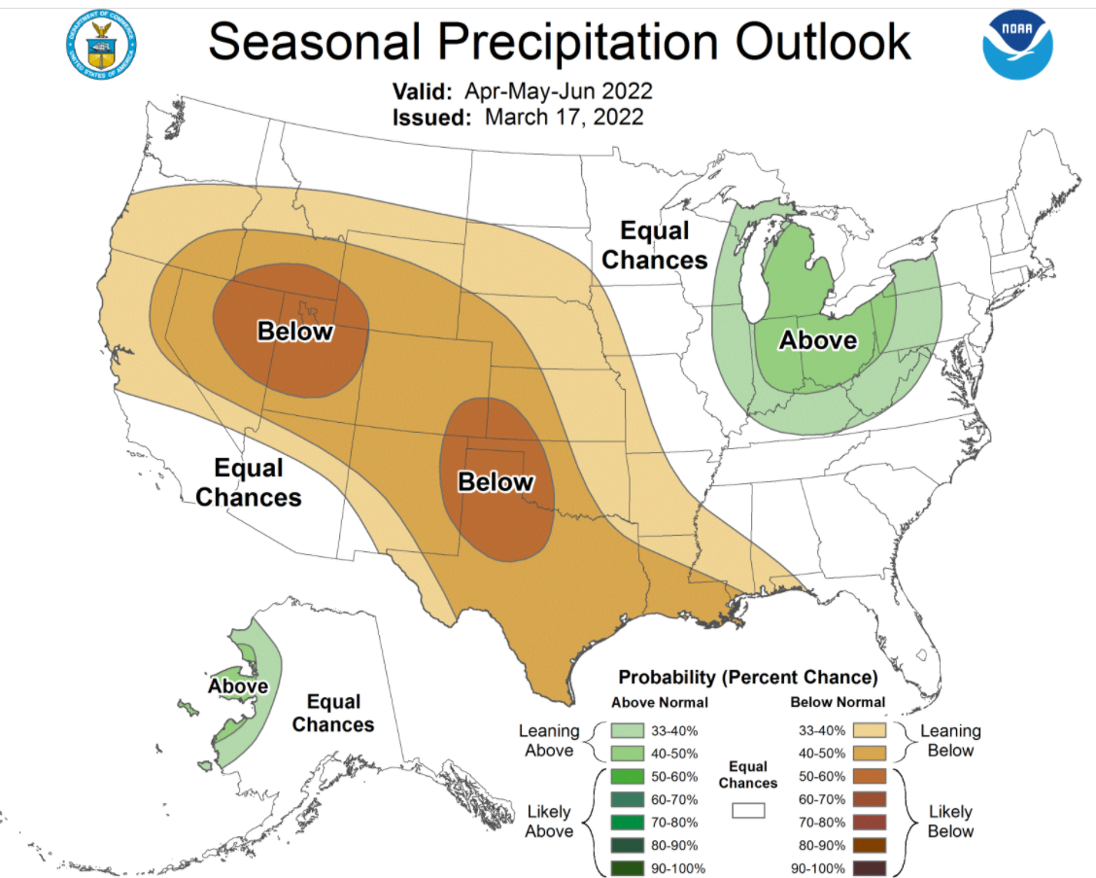
到2022年6月的降水展望
Moisture Outlook through June, 2022
The information in this report is derived from sources believed to be reliable and accurate . Creando Mañana assumes no responsibility or liability for any errors or omissions in this content. This content is provided on an “as is” basis with no guarantees of completeness, accuracy, usefulness, implied result or timeliness and without any warranties of any kind whatsoever, expressed or implied. The materials, ideas, suggestions, and or other items enclosed within this document are the sole property of Creando Mañana.
Creando Mañana

Slide 35
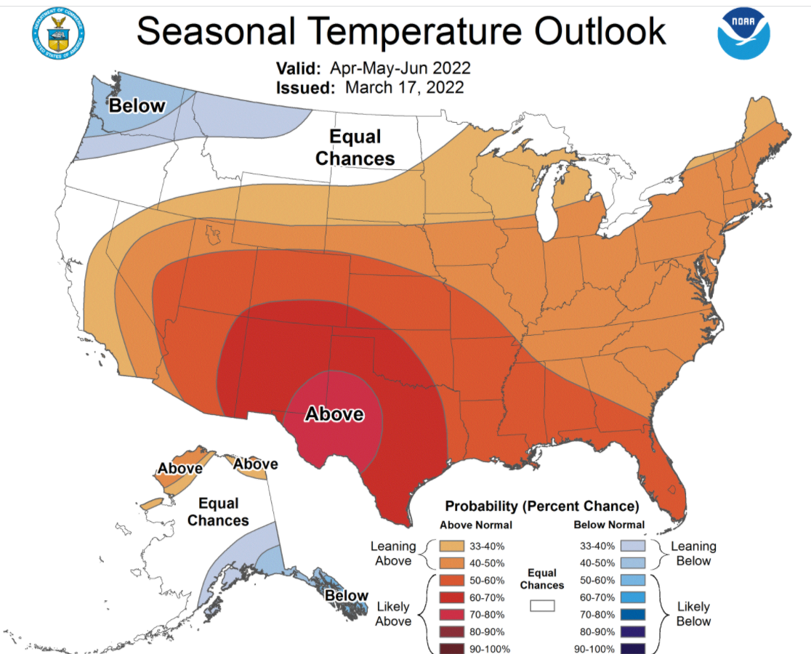
到2022年6月的气温展望
Temperature Outlook through June, 2022
The information in this report is derived from sources believed to be reliable and accurate . Creando Mañana assumes no responsibility or liability for any errors or omissions in this content. This content is provided on an “as is” basis with no guarantees of completeness, accuracy, usefulness, implied result or timeliness and without any warranties of any kind whatsoever, expressed or implied. The materials, ideas, suggestions, and or other items enclosed within this document are the sole property of Creando Mañana.
Creando Mañana

Slide 36

Ross Janssen
As a Kansas native, weather has always been a real passion for Ross for many different reasons. Growing up on a family farm and ranch just outside of Geneseo, it was easy to see how weather affected almost every aspect of agriculture and how important it was for us to know what kind of weather was on the horizon. Ross attended college at the University of Kansas and received a Bachelor of Science degree in Atmospheric Science. He earned the National Weather Association Seal of Approval in 2004, and received the Certified Broadcast Meteorologist designation in 2006 from the American Meteorological Society.

Slide 37

2022春/夏天气预报
Spring/Summer Forecast 2022
KWCH Chief Meteorologist Ross Janssen
Wichita, KS
Twitter: @KWCHRoss
Email: rjanssen@kwch.com

Slide 38
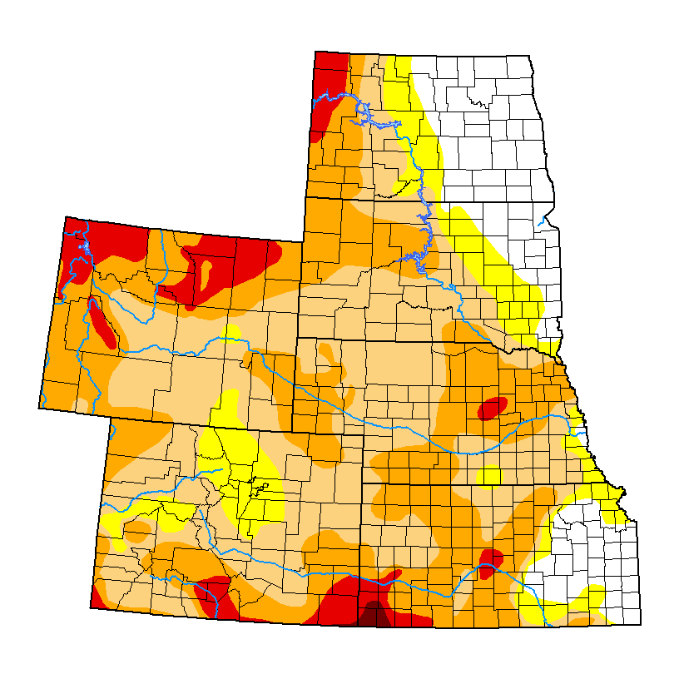
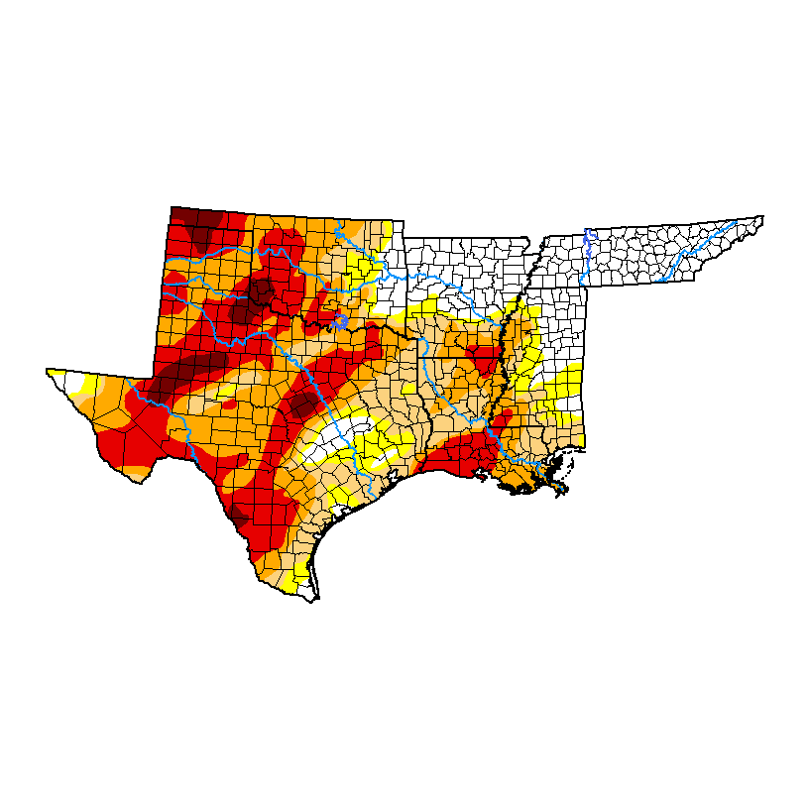
旱情
State of drought

Slide 39
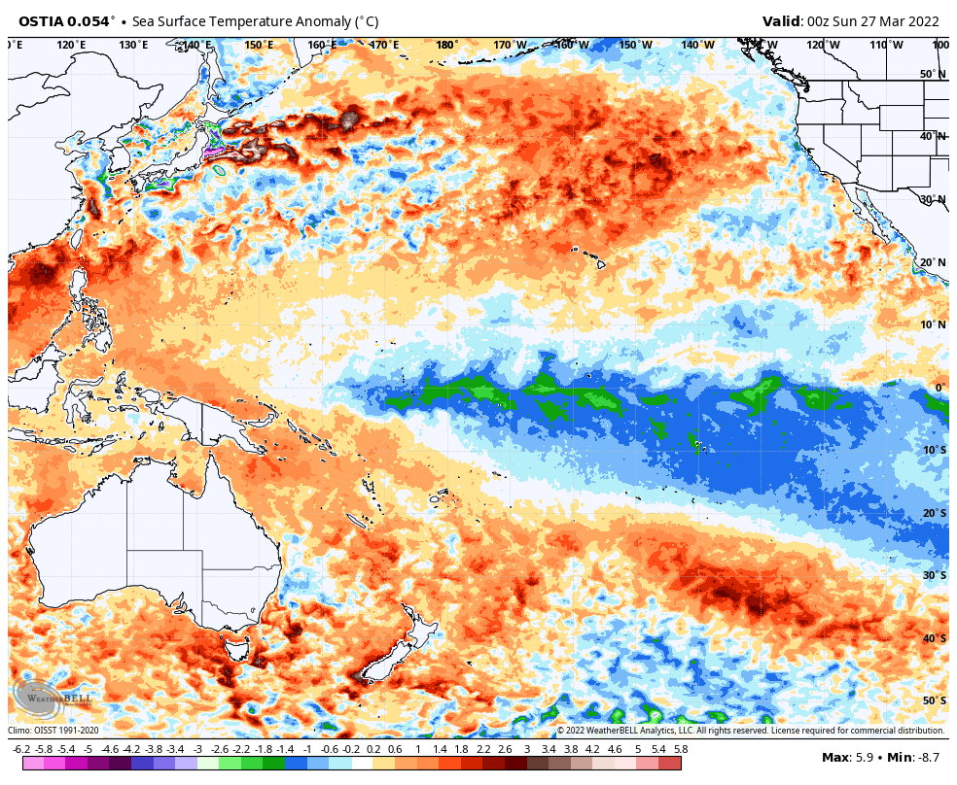
拉尼娜最新情况
La nina update
About 1°C colder than average

Slide 40
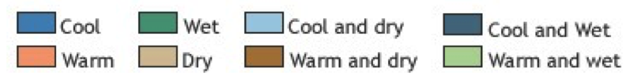
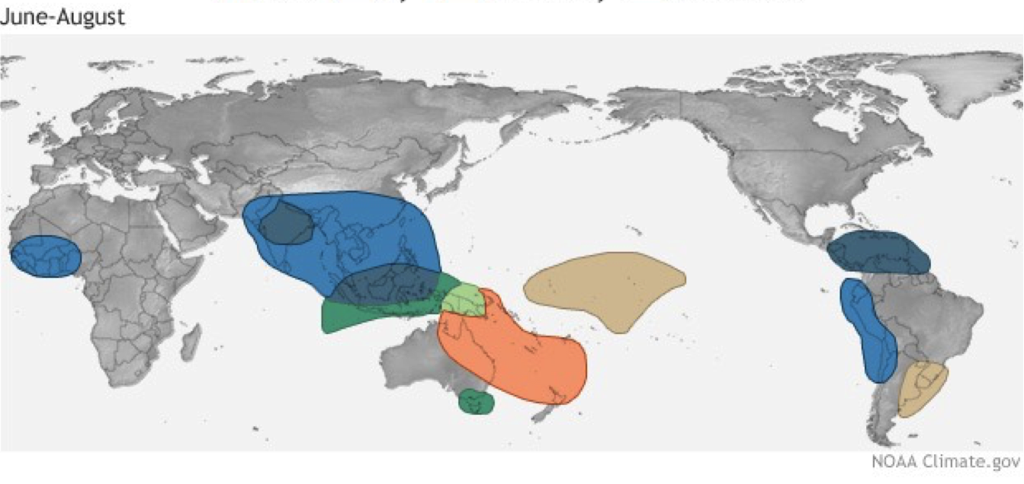
拉尼娜 – 夏季模式
La nina – summer pattern

Slide 41
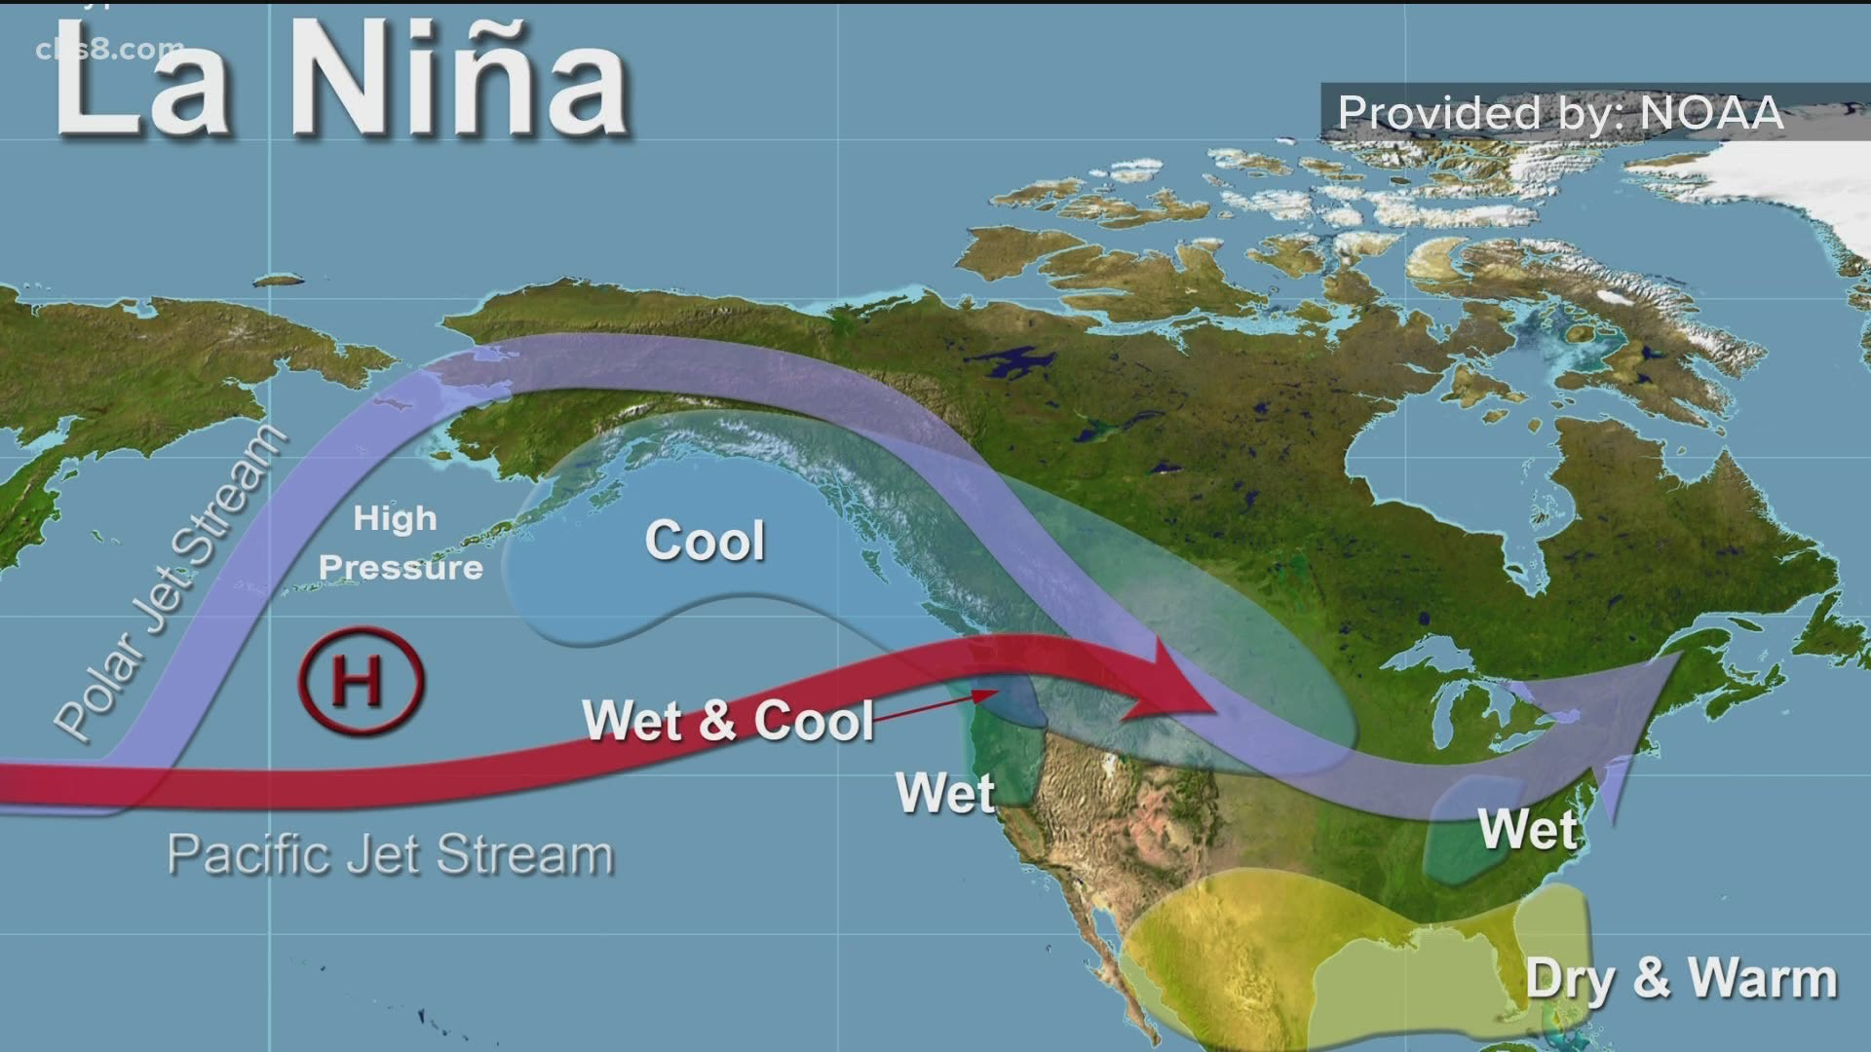
拉尼娜 – 夏季模式
La nina weather patterns
Summer months – provided by NOAA

Slide 42
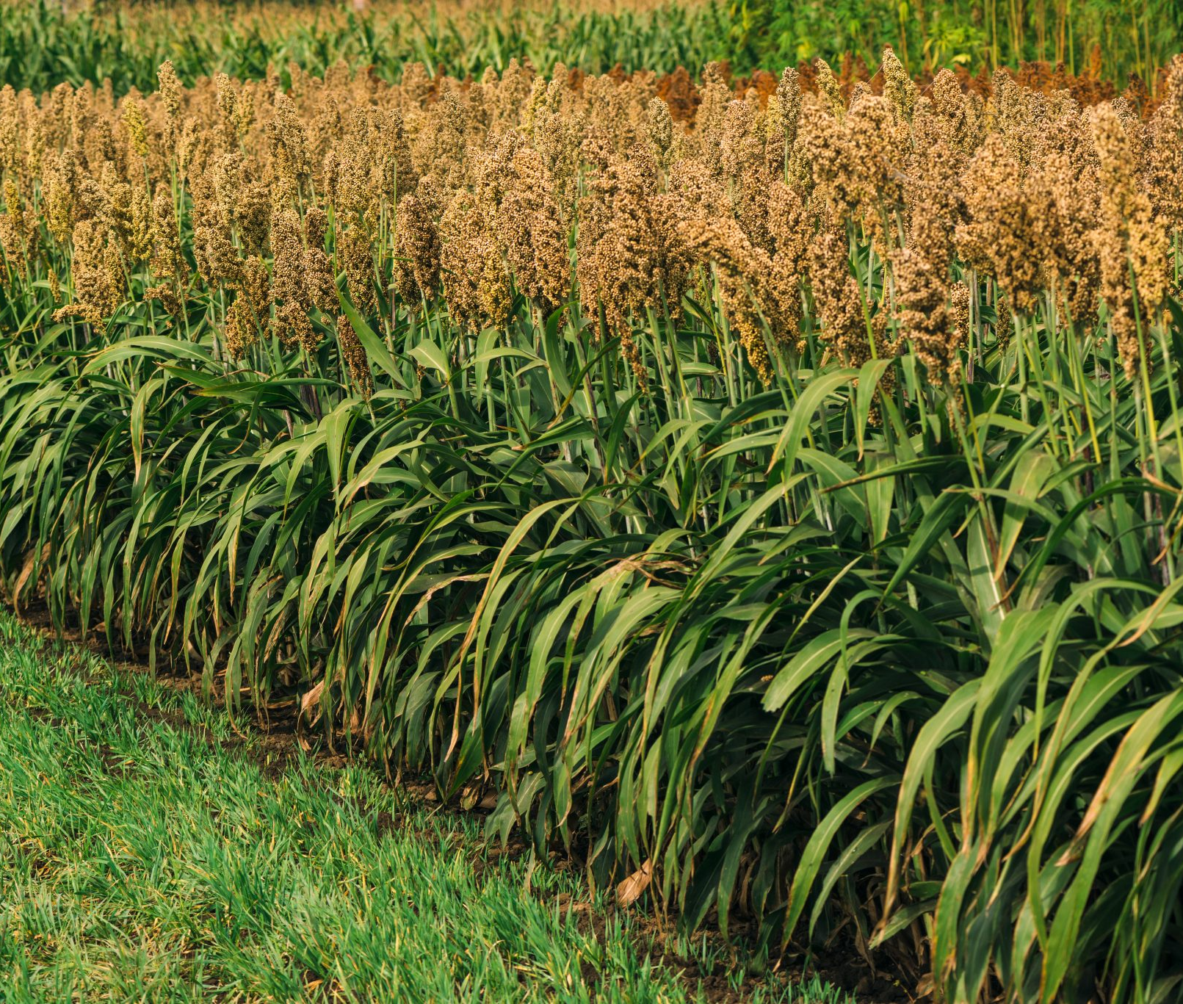
季度预报
Seasonal forecast
对生长季节的期望
Expectations for the growing season

Slide 43
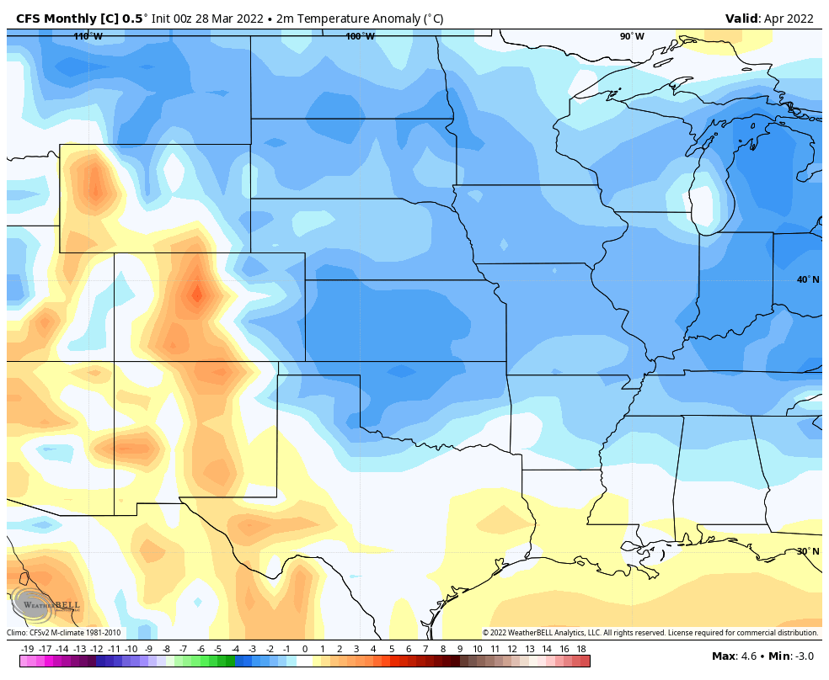
四月-气温
April - temperatures
平均高温
AVERAGE HIGHS: 65-75°F
平均低温
AVERAGE LOWS: 40-45°F
COOLER

Slide 44
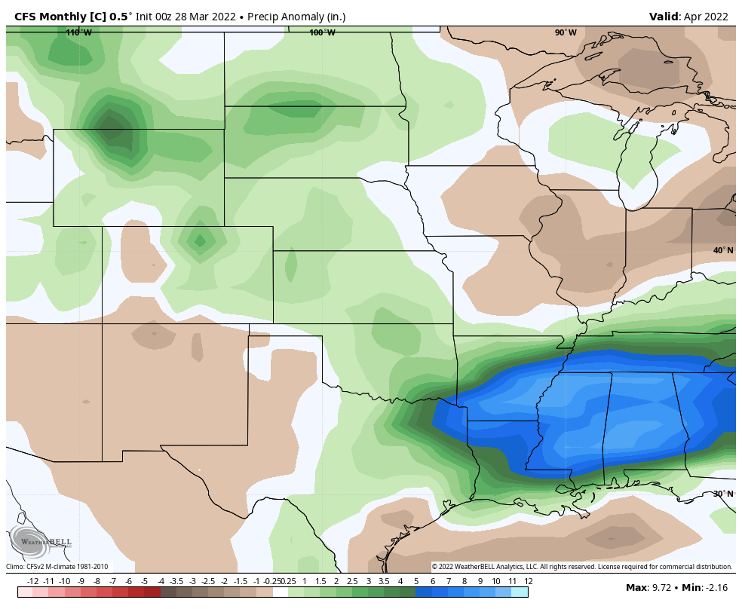
四月- 降水
April - moisture
平均降雨量:中部/南部平原3-4英寸
AVERAGE RAINFALL: 3-4” THROUGHOUT CENTRAL/SOUTHERN PLAINS
ABOVE AVERAGE

Slide 45
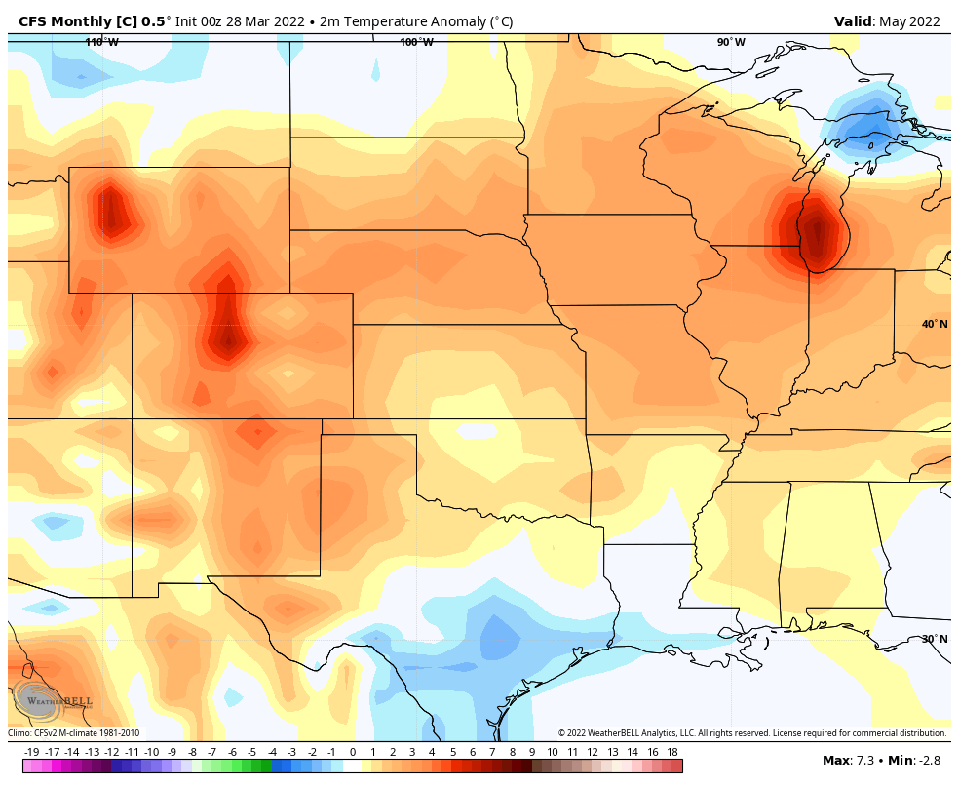
五月-气温
May - temperatures
平均高温
AVERAGE HIGHS: 75-85°F
平均低温
AVERAGE LOWS: 55-60°F

Slide 46
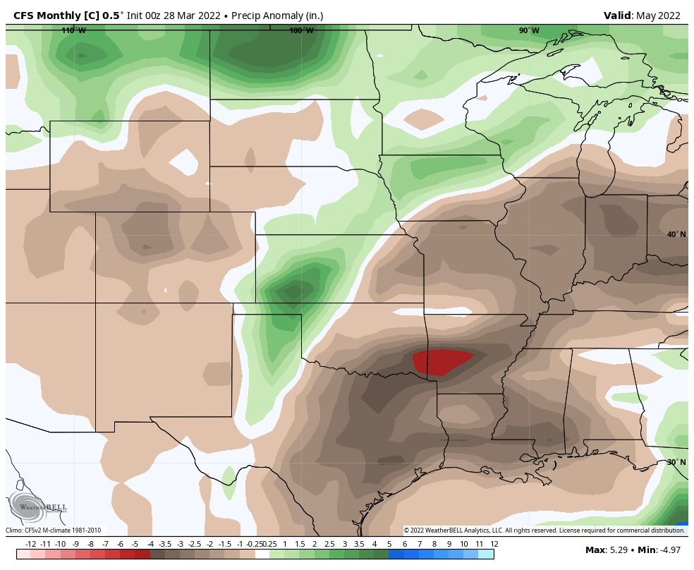
五月- 降水
May - moisture
平均降雨
AVERAGE RAIN: 3.5-5.5”

Slide 47
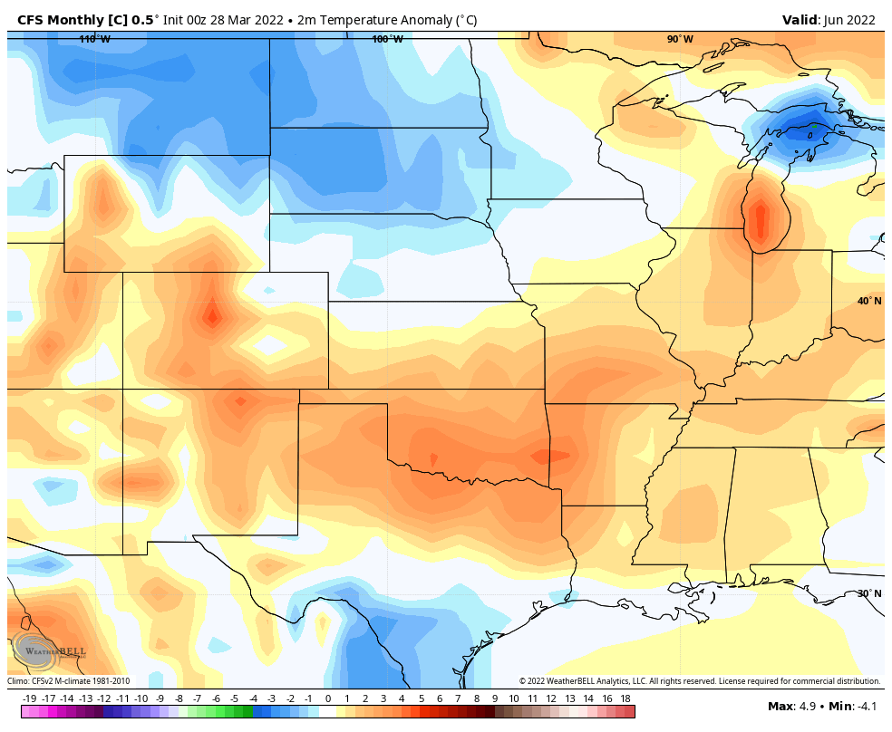
六月-气温
June - temperatures

Slide 48
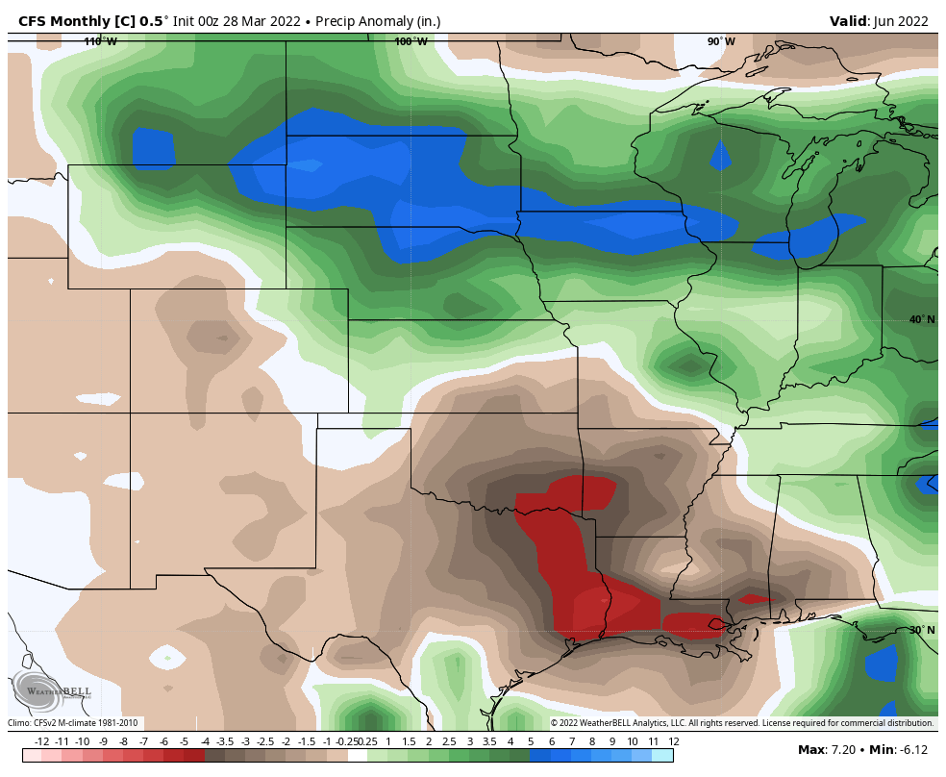
六月- 降水
June - moisture
AVERAGE RAIN: 3.5-5.5”

Slide 49
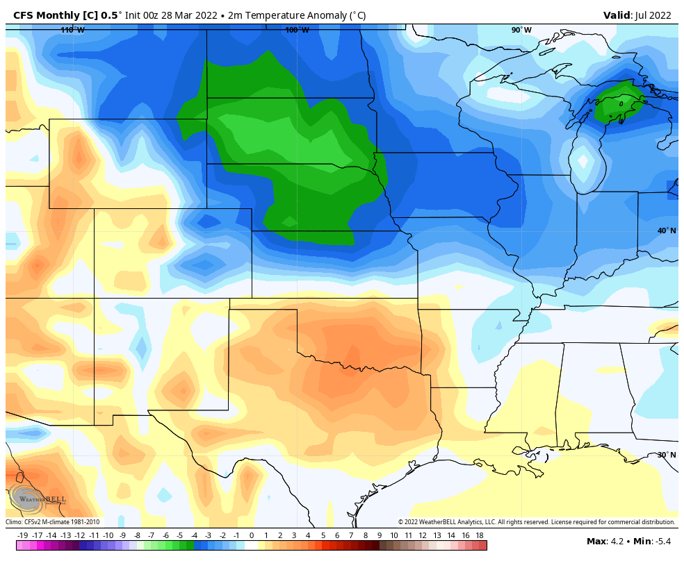
七月-气温
July - temperatures

Slide 50
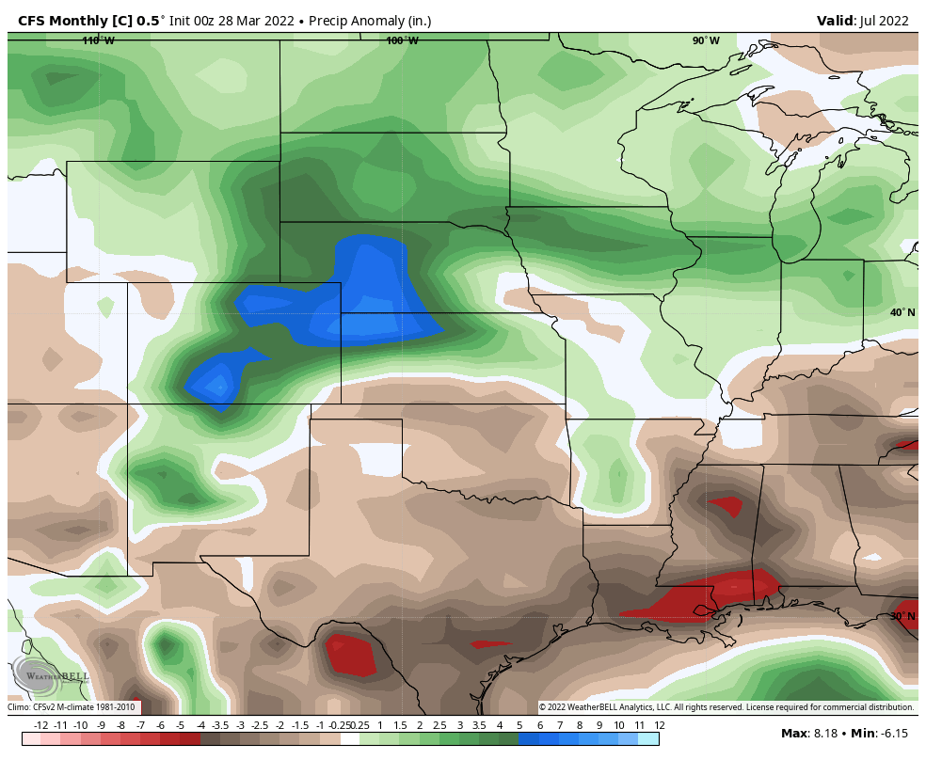
七月- 降水
July - moisture

Slide 51
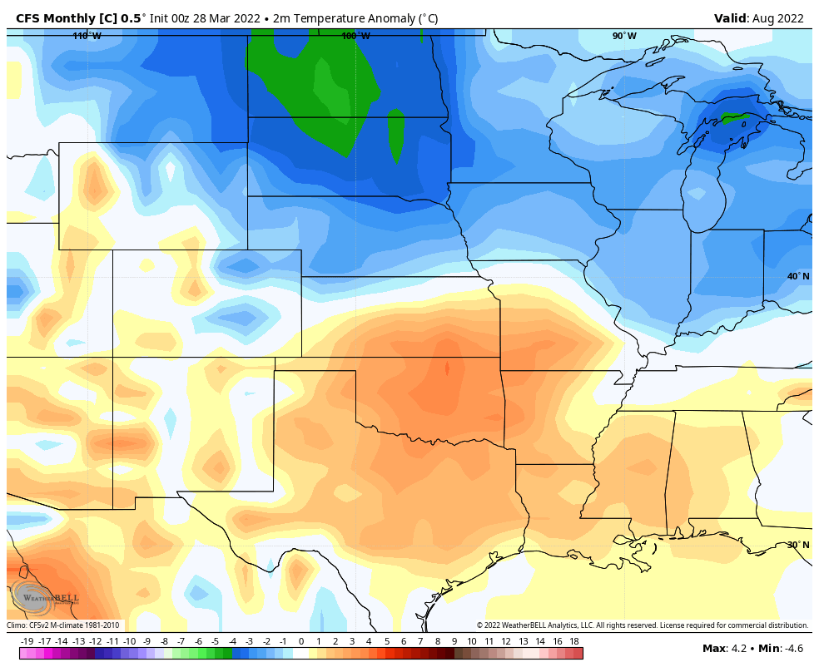
八月-气温
August - temperature

Slide 52
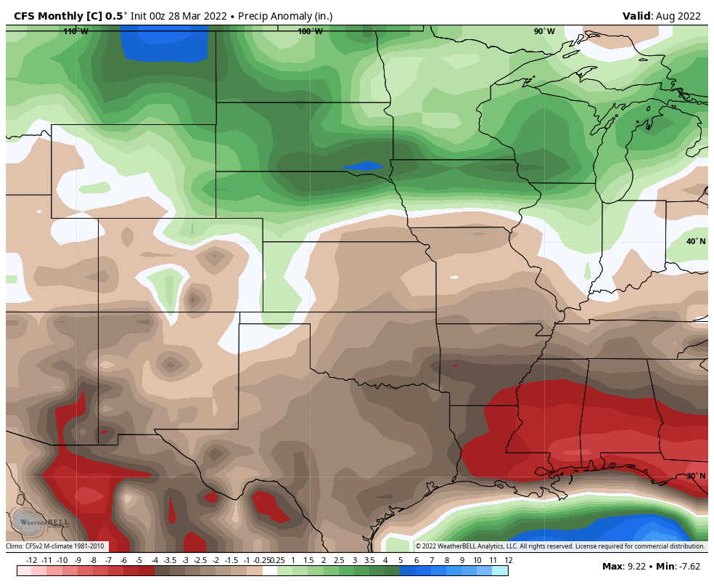
八月- 降水
August - moisture

Slide 53
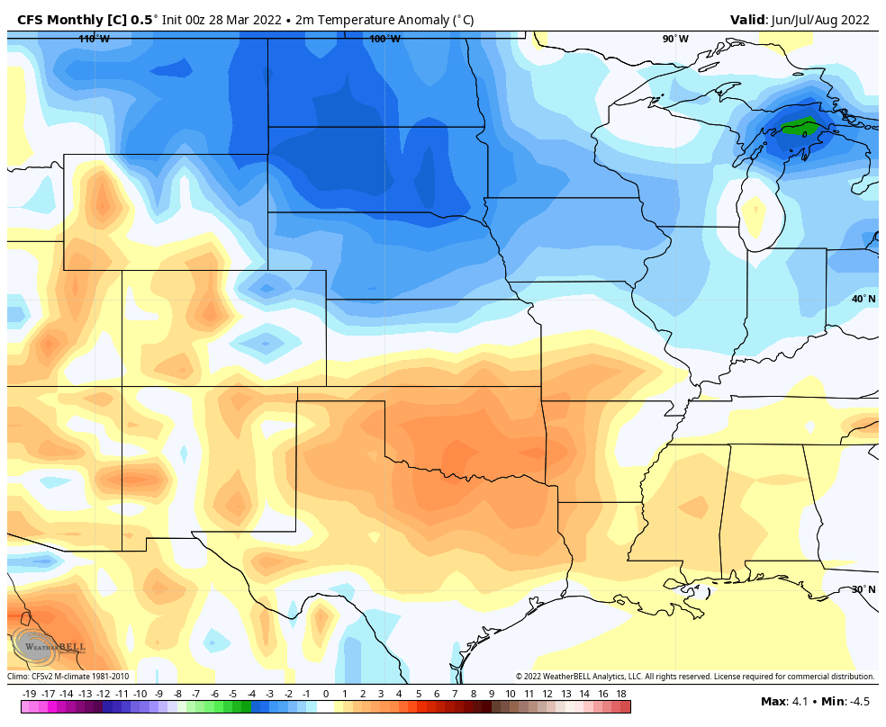
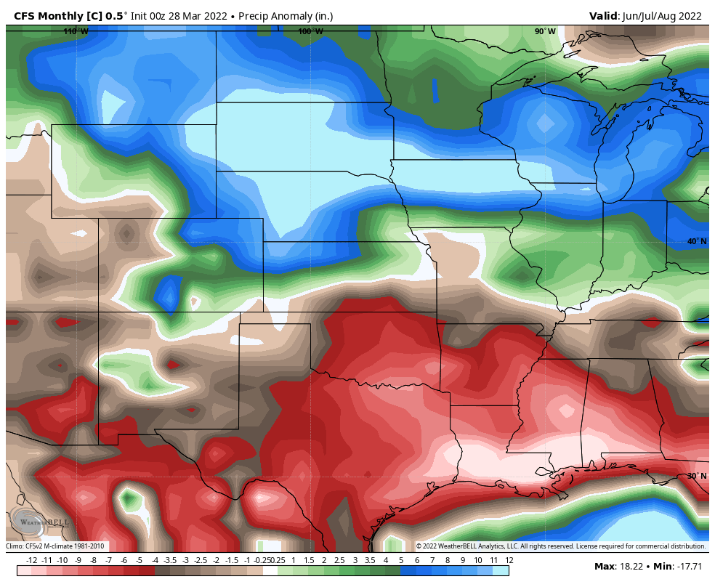
季度总结 Seasonal summary
JUNE/JULY/AUGUST

Slide 54
总结 IN SUMMARY
大部分降雨很有可能在春季/初夏(4月-6月)获得
MORE LIKELY TO GET MOST OF OUR RAINFALL IN SPRING/EARLY SUMMER (APRIL-JUNE)
夏季天气模式可能干旱 (7月/8月)
DRIER SUMMER PATTERNS LIKELY (JULY/AUGUST)
今年夏天高温即将来临，尤其是在最南部
A HOT SUMMER AHEAD, ESPECIALLY FARTHER SOUTH
干旱状况持续存在
DROUGHT CONDITIONS PERSIST

Slide 55

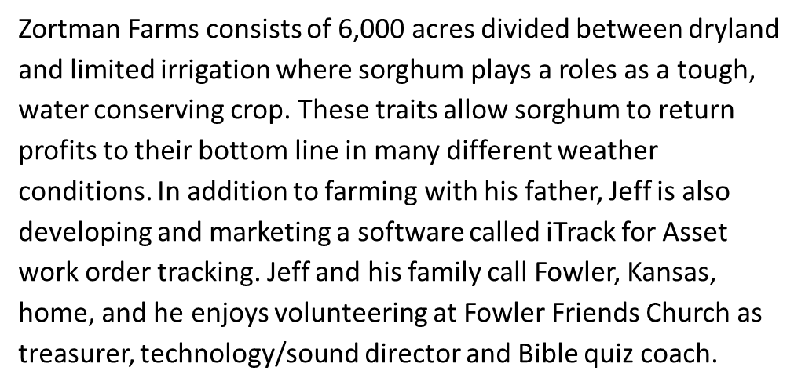
Jeff Zortman

Slide 56
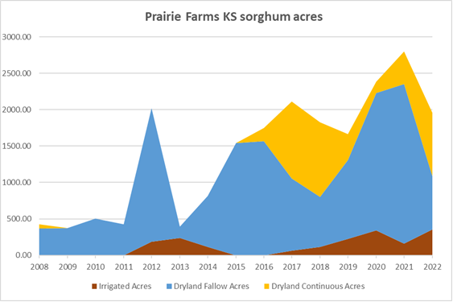

Slide 57

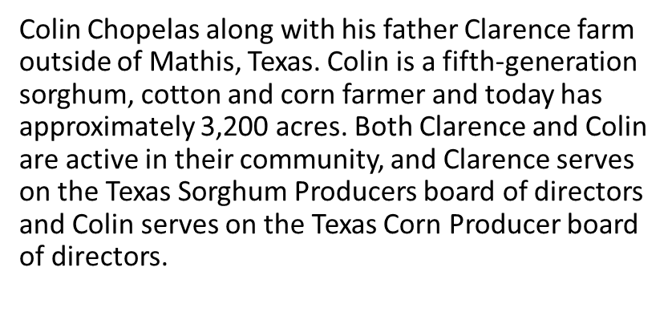
Colin Chopelas

Slide 58
问答环节
Question & Answer Session

